Slide 1

Team 19: Pedigree analysis
Nicole Wu, Sophie Liang, Tracy Chan, Annika Tran

Slide 2

Summary
A pedigree chart is a diagram that documents how a genetic trait is pass on in a family, from one generation to another
A trait can be either dominant or recessive:
Dominant traits only need one affected allele to be expressed
Recessives traits are only expressed when both alleles are affected
And a trait can be x-linked or autosomal:
Autosomal traits are located on all the chromosomes except the X or Y chromosome
X-linked traits are located on the X chromosomes
X-linked traits are more likely to affect males
When given a pedigree chart, our model will track family members affected by a trait to determine if a trait is: dominant or recessive, and autosomal or X-linked

Slide 3
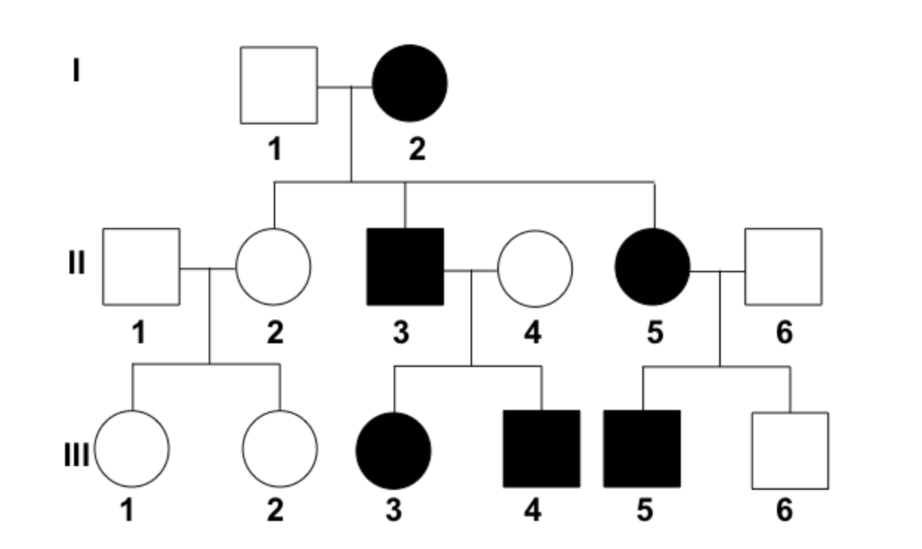

Propositions
j
S_{gj}: is true if the family member at position (g,j) is female
True if they are female
False if they are male
Eg. S_{i2} is true (circle is female)
A_{gj}: is true if the family member at position (g,j) is affected
True if they are affected
False if they are not affected
Eg. A_{ii3} is true (filled in means affected)
R_{gj}: is true if a family member at position (g,j) is a blood relative
True if they are a descent
False if they are not a descent (eg. They married into the family)
Eg. R_{ii1} is false
g
Notes:
Describe each of the types of propositions in your problem.
Use a bulleted list.
Clearly indicate what it means for the proposition to be true.

Slide 4
Propositions
P_{i}: is true if both parents in generation I are unaffected (if both parents are unaffected by a trait but some of their decedents are, the trait is recessive)
P_{i} is false for the chart on the left
M_{g}: is true if more male family members are affected in a generation
M_{ii} is false
j
g

Slide 5
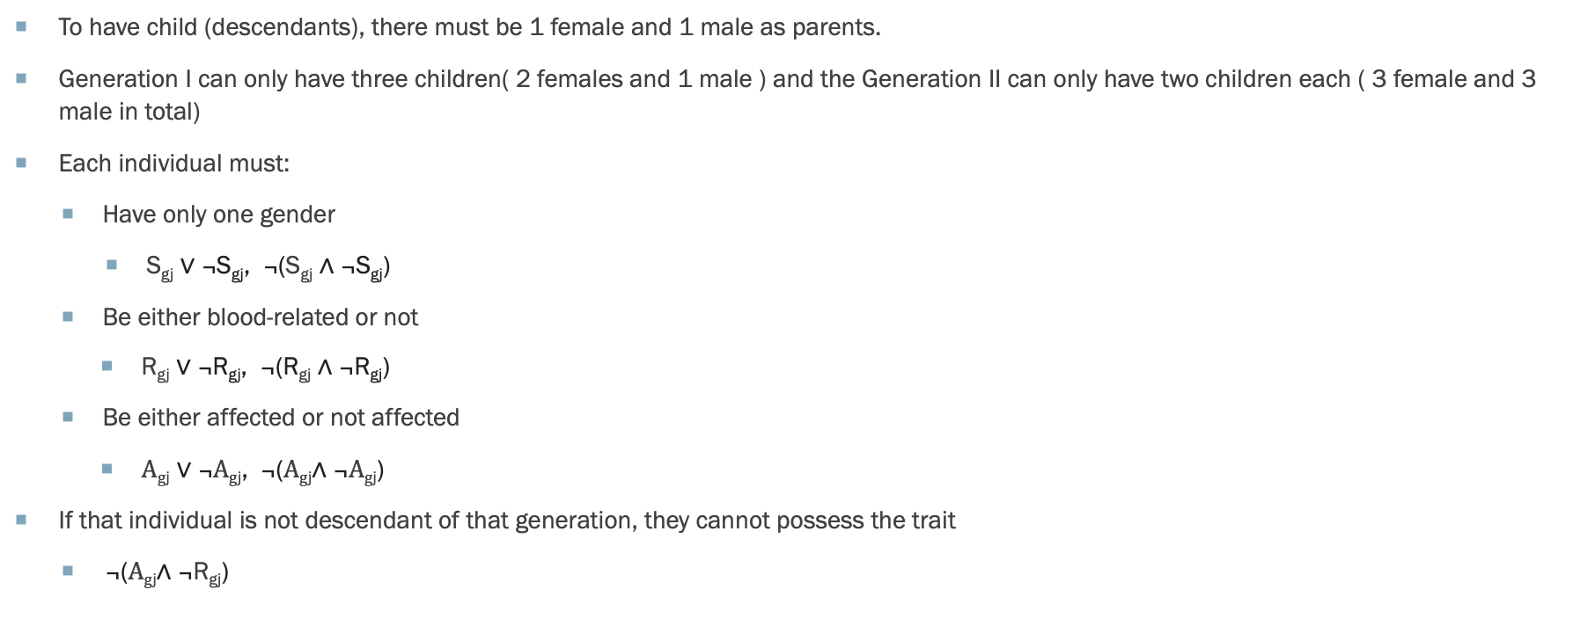
Constraints
To have child (descendants), there must be 1 female and 1 male as parents.
Generation I can only have three children( 2 females and 1 male ) and the Generation II can only have two children each ( 3 female and 3 male in total)
Each individual must:
Have only one gender
S_{gj} ∨ ¬S_{gj}, ¬(S_{gj} ∧ ¬S_{gj})
Be either blood-related or not
R_{gj} ∨ ¬R_{gj}, ¬(R_{gj} ∧ ¬R_{gj})
Be either affected or not affected
$\text{A}\text{g}\text{j} \text{∨ ¬}\text{A}\text{g}\text{j}\text{, ¬(}\text{A}\text{g}\text{j}\text{∧} \text{¬}\text{A}\text{g}\text{j}\text{)}$
If that individual is not descendant of that generation, they cannot possess the trait
$\text{¬(}\text{A}\text{g}\text{j}\text{∧} \text{¬}\text{R}\text{g}\text{j}\text{)}$

Slide 6
Constraints
P_{g} holds only when both parents are not affected
P_{g} ↔ (¬A_{i1} ∧ ¬A_{i2} )
M_{g} holds only when more male family members are affected in a generation than female members
For example, in generation ii if 1 male is affected and no females are affected then M_{g} holds
M_{g} ↔(¬S_{ii1} ∧ A_{ii1} ) ∧(S_{ii2} ∧ ¬A_{ii2} ) ∧ (S_{ii3} ∧ ¬A_{ii3} )

Slide 7
End

